Slide 1
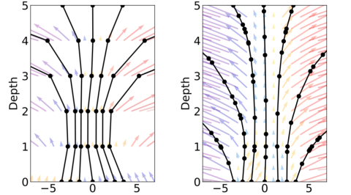
An Introduction to Neural ODEs
hep-ai
1/22/2019
James Giammona

Slide 2
Neural ODEs
Won Best Paper Award at NeurIPS 2018
By Ricky T. Q. Chen*, Yulia Rubanova*, Jesse Bettencourt*, David Duvenaud
All authors are at the University of Toronto and the Vector Institute
Paper is at arXiv:1806.07366

Slide 3
Outline
Main Idea
Advantages
Backprop through an ODE solver
Comparisons to Supervised ResNets
Continuous Normalizing Flows
Continuous Time Latent Variable Model
More Recent Work

Slide 4
Learning Residuals
Deep Residual Learning introduced the idea of learning a difference from a previous hidden layer’s output
Allowed the training of much deeper networks
He, Zhang, Ren, Sun (2015) arxiv:1512.03385
Notes:
From resnet, RNN, or normalizing flow to Neural ODE

Slide 5
Hidden State Transformation
ResNets, recurrent neural network decoders and normalizing flows compose a sequence of transformations to a hidden state
Looks like Euler discretization of continuous transformation
Let’s take the limit of more layers and smaller steps (dt)
Following https://rkevingibson.github.io/blog/neural-networks-as-ordinary-differential-equations/
Notes:
From resnet, RNN, or normalizing flow to Neural ODE

Slide 6
Main Idea
Starting from the input layer h(t₀) we define the output layer h(T) as the solution to the ODE initial value problem at time T
We can compute h(T) using a black-box differential equation solver
Notes:
Main Idea

Slide 7
Advantages of Neural ODE approach
Memory Efficiency – Because of the clever way of computing gradients of loss through the ODE solver, one can train the network with a constant memory cost as a function of depth!
Adaptive Computation – Modern ODE solvers monitor and adapt evaluation to limit approximation errors. Cost of model scales as problem complexity. Accuracy can be reduced for deployment.
Parameter Efficiency – Reduced number of parameters needed for supervised learning due to implicit tying together of “layers”
Scalable and invertible normalizing flows – Easier and more natural to compute (more below)
Continuous time series models – Naturally incorporates continuous time series data without discretization (more below)
Notes:
Advantages

Slide 8
Backprop through an ODE Solver
Use the adjoint sensitivity method to compute gradients of the loss by solving a second ODE backwards in time
This method scales linearly with problem size, has low memory cost and controls numerical error
Pontryagin, et al. The mathematical theory of optimal processes. 1962.
Notes:
Backprop through ODE solver 1

Slide 9
Backprop through an ODE Solver
Vector-Jacobians can be efficiently computed using automatic differentiation for about the cost of evaluating f
Notes:
Backprop through ODE solver 1

Slide 10
Supervised Learning vs. ResNets
Compared black-box ODE Net and Runge-Kutta Net with 6 block ResNet and 300 hidden unit MLP
L for ODE Net is number of function evaluations for one forward pass of the ODE Solver
Number of function evaluations increases throughout training
Notes:
Supervised Learning

Slide 11
Continuous Normalizing Flows
Normalizing flow requires computation of determinant of Jacobian
This has a cubic cost in dimension of z or in number of hidden units
With a continuous transformation, one only needs the trace!
Trace is a linear function making flow models with many hidden units easy to evaluate!
Planar Normalizing Flow (Rezende and Mohamed, 2015)
Continuous Analog of Planar Normalizing Flow
Notes:
Continuous Normalizing Flows

Slide 12
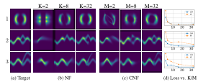
Continuous Normalizing Flows
Reverse transformation has same cost as forward pass for CNF. Not the case for normalizing flows.
Notes:
Continuous Normalizing Flows

Slide 13
Generative Latent Function Time Series Model
We represent a time series of observations using a latent trajectory.
Latent trajectory is parameterized by z₀ and dynamics shared by all trajectories
We train this model as a VAE and use an RNN to transform inputs to a latent space
Notes:
Continuous Time Series Latent Variable Model

Slide 14
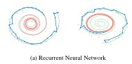
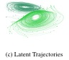
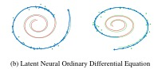
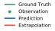
Generative Latent Function Time Series Model
RNN has 25 hidden units. 4 dimensional latent space. Dynamics parameterized by function with 20 hidden units
Notes:
Continuous Time Series Latent Variable Model

Slide 15
Recent Work
FFJORD: FREE-FORM CONTINUOUS DYNAMICS FOR SCALABLE REVERSIBLE GENERATIVE MODELS (arxiv: 1810.01367)
By Will Grathwohl, Ricky T. Q. Chen, Jesse Bettencourt , Ilya Sutskever , David Duvenaud
Continues work on reversible generative models
Notes:
More Recent Work

